Slide 1

Introduction to Hive and Spark: Big Data Processing and Analysis
Exploring essential technologies for data efficiency
Notes:
--- Big Data processing is revolutionizing how businesses analyze and utilize data. In this presentation, we will explore two essential technologies, Apache Hive and Apache Spark, that enable efficient big data processing and analysis.

Slide 2
Agenda Items
Overview of Big Data Technologies
Apache Hive: Data Warehousing Solution
Apache Spark: Unified Analytics Engine
Hive and Spark Integration
Future Trends and Developments
Notes:
We will begin with an overview of big data technologies, discussing their definition, importance, and challenges. Next, we'll dive into Apache Hive as a data warehousing solution, followed by an exploration of Apache Spark as a unified analytics engine. We will also look at the integration of Hive and Spark, and conclude with future trends and developments in big data.

Slide 3
Overview of Big Data Technologies
Notes:
Understanding big data technologies is crucial for organizations looking to harness the power of data. This section will cover the foundational concepts that shape big data processing.

Slide 4

Definition and Importance of Big Data
Understanding Big Data
Big data encompasses large and complex data sets that require advanced tools for processing and analysis.
Insights and Analytics
Analyzing big data allows organizations to extract valuable insights that can inform strategic decision-making and operational improvements.
Enhancing Customer Experience
Effective use of big data can significantly enhance customer experiences by personalizing interactions and improving service delivery.
Notes:
Big data refers to large and complex data sets that traditional data processing software cannot manage efficiently. The ability to analyze big data enables organizations to gain insights, improve decision-making, and enhance customer experiences.

Slide 5

Challenges in Big Data Processing
Data Volume Challenges
Organizations face difficulties managing the sheer volume of data generated, requiring robust storage solutions.
Data Velocity Issues
The speed at which data is generated and needs to be processed presents significant challenges for timely analysis.
Data Variety Complexity
Managing various data types and sources can complicate data integration and analysis efforts.
Ensuring Data Quality
Maintaining data quality is crucial, as poor-quality data can lead to inaccurate insights and decisions.
Notes:
Processing big data comes with challenges such as data volume, velocity, and variety. Organizations often face issues related to data storage, processing speed, and ensuring data quality.

Slide 6
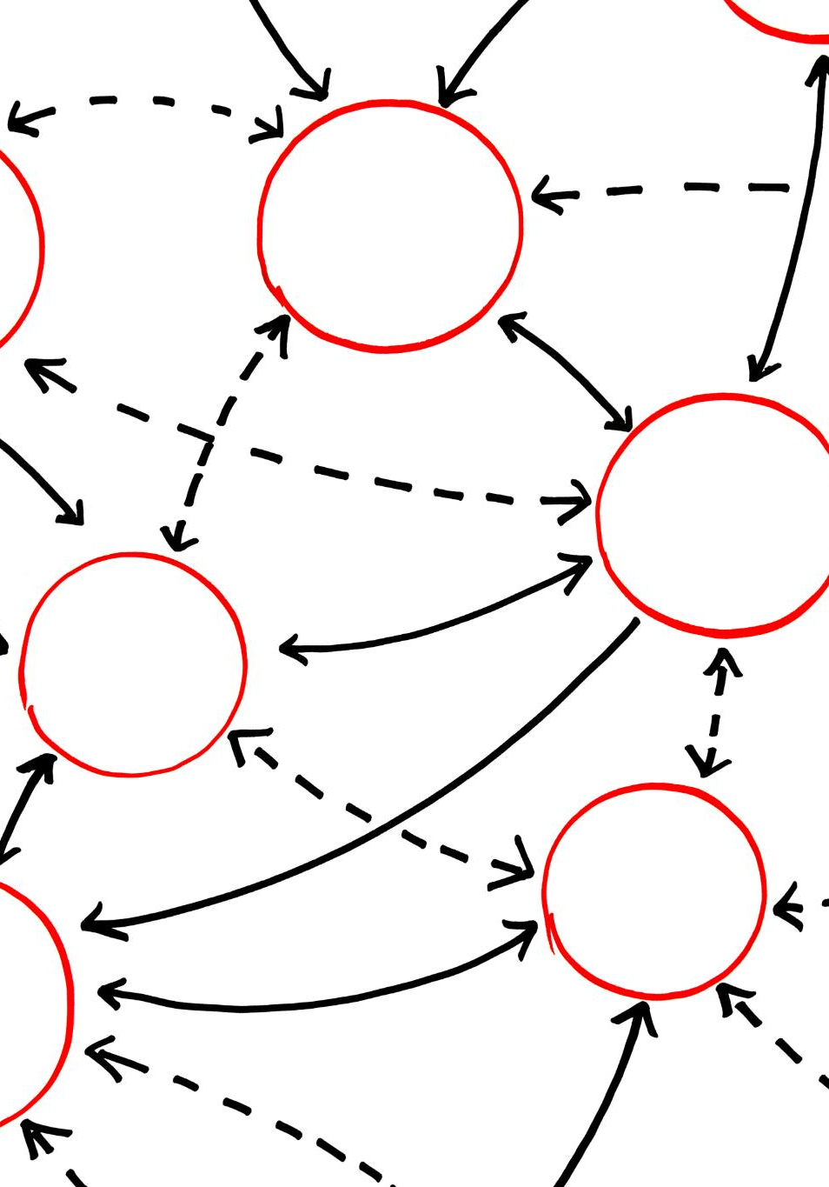
Key Technologies in the Big Data Ecosystem
Hadoop Framework
Hadoop is an open-source framework that allows for the distributed processing of large data sets across clusters of computers using simple programming models.
NoSQL Databases
NoSQL databases provide flexible data models and are designed to handle large volumes of structured and unstructured data in real-time.
Data Processing Frameworks
Frameworks like Hive and Spark enable fast, iterative processes for big data analysis and are essential in extracting insights from large data sets.
Notes:
The big data ecosystem includes technologies like Hadoop, NoSQL databases, and data processing frameworks like Hive and Spark. Each technology plays a vital role in managing and analyzing big data efficiently.

Slide 7
Apache Hive: Data Warehousing Solution
Notes:
Apache Hive is a data warehousing solution built on top of Hadoop. It allows for querying and managing large datasets through a SQL-like interface, making it accessible for users familiar with traditional databases.

Slide 8
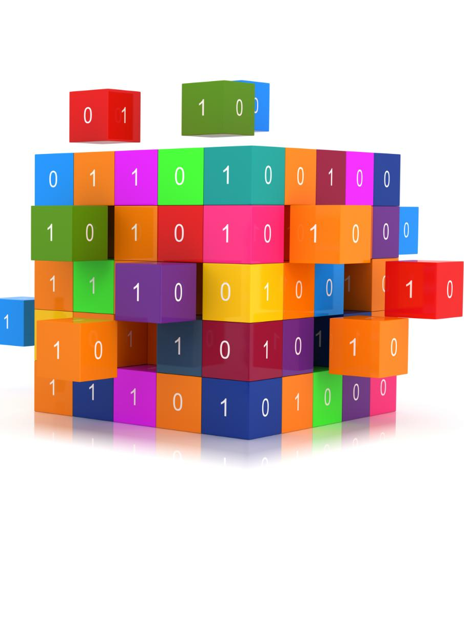
Introduction to Apache Hive
High-Level Abstraction
Hive offers a high-level abstraction that simplifies data processing, making it accessible for analysts without programming expertise.
SQL Queries to MapReduce
Hive converts SQL queries into MapReduce jobs, allowing efficient processing of large datasets in a familiar format.
User-Friendly for Analysts
By using Hive, analysts can work with significant amounts of data without needing deep technical knowledge of programming.
Notes:
Hive provides a high-level abstraction for processing big data by converting SQL queries into MapReduce jobs. This makes it easier for analysts to work with large datasets without needing to understand complex programming.

Slide 9

Architecture and Components
Hive Metastore
The Hive Metastore is responsible for storing metadata about tables, columns, and data types, essential for query processing.
Hive Driver
The Hive Driver compiles queries into executable plans, coordinating the interaction between the user and the execution engine.
Execution Engine
The Execution Engine executes the plans generated by the Hive Driver on the Hadoop clusters, managing the data processing tasks.
Notes:
Hive's architecture consists of several components, including the Hive Metastore, Hive Driver, and Execution Engine. These components work together to store metadata, compile queries, and execute them on Hadoop clusters.

Slide 10

Use Cases and Applications
Data Warehousing
Hive is extensively utilized for data warehousing solutions, facilitating efficient storage and retrieval of large datasets.
ETL Processes
In ETL (Extract, Transform, Load) processes, Hive aids in data preparation and handling for analytics and reporting.
Business Intelligence
Hive supports business intelligence efforts across various industries, helping organizations derive actionable insights from their data.
Industry Applications
Industries like finance, healthcare, and e-commerce leverage Hive for data analysis and decision-making, enhancing operational efficiency.
Notes:
Hive is widely used for data warehousing, ETL processes, and business intelligence. Industries like finance, healthcare, and e-commerce leverage Hive to gain insights from large datasets.

Slide 11
Apache Spark: Unified Analytics Engine
Notes:
Apache Spark is a powerful analytics engine designed for speed and ease of use. It supports batch processing, stream processing, and machine learning, making it a versatile tool for big data analytics.

Slide 12

Introduction to Apache Spark
In-Memory Computing
Apache Spark utilizes in-memory computing which allows for significantly faster data processing compared to traditional disk-based systems.
Support for Multiple Languages
Spark supports multiple programming languages such as Scala, Java, and Python, making it accessible to a wide range of developers.
Notes:
Spark provides an in-memory computing framework, significantly improving the speed of data processing compared to traditional disk-based systems. It supports multiple programming languages, including Scala, Java, and Python.

Slide 13

Key Features and Benefits
High Speed Processing
Spark offers high-speed processing capabilities, allowing users to analyze large datasets quickly and efficiently.
User-Friendly Interface
The ease of use of Spark's interface enables users of all skill levels to work with data effortlessly.
Real-Time Data Analytics
Spark's capability to process data in real-time is crucial for timely decision-making in big data projects.
Diverse Data Handling
Spark's ability to handle various data types makes it versatile for different analytics projects.
Notes:
Some key features of Spark include its speed, ease of use, and support for advanced analytics. Its ability to process data in real-time and handle diverse data types makes it an indispensable tool for big data projects.

Slide 14

Use Cases and Applications
Real-Time Data Processing
Spark enables real-time data processing, allowing companies to analyze and act on data as it arrives, enhancing decision-making.
Machine Learning Integration
Spark provides powerful tools for machine learning, enabling organizations to build and deploy predictive models efficiently.
Interactive Analytics
With Spark, businesses can perform interactive analytics, allowing users to explore data and gain insights quickly and intuitively.
Notes:
Spark is utilized in various applications such as real-time data processing, machine learning, and interactive analytics. Companies across sectors use Spark to improve operational efficiency and drive data-driven strategies.

Slide 15
Hive and Spark Integration
Notes:
Integrating Hive and Spark enables organizations to harness the best of both technologies. This section will examine how they can work together for enhanced data processing capabilities.

Slide 16

Interoperability and Data Processing
Seamless Integration
Hive and Spark work together seamlessly, enhancing data processing capabilities while maintaining user-friendly SQL queries.
SQL Capabilities
Leverage Hive's SQL capabilities to perform complex queries and analysis on large datasets efficiently.
In-Memory Processing
Utilize Spark's in-memory processing power to significantly reduce data processing times for rapid insights.
Notes:
Hive and Spark can operate together seamlessly, allowing users to leverage Hive's SQL capabilities while utilizing Spark's in-memory processing power. This integration boosts performance and reduces processing times.

Slide 17

Performance Improvements with Spark SQL
Faster Execution Engine
Spark SQL offers a faster execution engine compared to Hive, significantly reducing query processing time.
Efficient Querying
It enables more efficient querying, optimizing how queries are executed and resources are utilized.
Better Resource Management
Spark SQL improves resource management, allowing better allocation of system resources for enhanced performance.
Notes:
Spark SQL provides a faster execution engine compared to Hive's traditional MapReduce. It allows for more efficient querying and better resource management, significantly improving performance.

Slide 18

Case Studies and Real-World Examples
Successful Implementations
Many organizations have integrated Hive and Spark to enhance their data processing capabilities significantly.
Efficiency Gains
The integration of these technologies has led to remarkable improvements in data processing efficiency and speed.
Insight Generation
Organizations have leveraged Hive and Spark for generating deeper insights from their data, driving informed decision-making.
Notes:
Numerous organizations have successfully implemented Hive and Spark integration, achieving remarkable results in data processing efficiency and insight generation. We will look at some notable case studies.

Slide 19
Future Trends and Developments
Notes:
The field of big data is constantly evolving. In this section, we will discuss the future trends and developments that are shaping the landscape of data processing technologies.

Slide 20

Advancements in Data Processing Technologies
Real-Time Analytics
Real-time analytics enables organizations to process data as it is generated, leading to timely insights and decisions.
Artificial Intelligence
AI technologies are enhancing data processing capabilities, allowing for smarter data management and predictive analyses.
Machine Learning
Machine learning tools are enabling systems to learn from data, improving accuracy and efficiency over time.
Notes:
Emerging technologies such as real-time analytics, AI, and machine learning are pushing the boundaries of what is possible with big data. These advancements will fuel more efficient and effective data processing solutions.

Slide 21

Emerging Use Cases in Various Industries
Healthcare Innovations
In healthcare, big data is used for predictive analytics, patient care improvement, and operational efficiency, transforming the medical field.
Financial Services Optimization
The finance sector leverages big data for risk management, fraud detection, and personalized financial services, enhancing security and customer trust.
Retail Customer Experience
Retailers utilize big data to analyze consumer behavior, optimize inventory, and personalize marketing strategies to improve customer satisfaction.
Notes:
As big data technologies advance, new use cases are emerging in sectors like healthcare, finance, and retail. Organizations are leveraging big data to enhance customer experience and streamline operations.

Slide 22

The Future of Hive, Spark, and Big Data
Evolving Technologies
Hive and Spark are evolving to better handle the increasing volume and complexity of data in real-time applications.
Industry Adaptation
Industries are adapting Hive and Spark technologies to improve their data analysis capabilities and decision-making processes.
Future Prospects
The future of big data technologies holds great promise with advancements in AI, machine learning, and automation.
Notes:
The future holds great promise for Hive, Spark, and big data technologies as they continue to evolve and adapt to meet the growing demands of data processing and analysis across industries.

Slide 23
Conclusion
Role of Hive
Hive facilitates data summarization and querying, making it easier for analysts to derive insights from large datasets.
Role of Spark
Spark provides fast data processing capabilities, allowing for real-time analytics and complex computations on big data.
Integration Importance
Integrating Hive and Spark enhances data management and analysis, providing organizations with robust tools for big data challenges.
Notes:
In summary, Hive and Spark are integral to the big data ecosystem, each offering unique strengths for data processing and analysis. Understanding their capabilities and integration is crucial for organizations looking to leverage big data effectively.

